Slide 1
MongoDB VS SQL
Created by Mamia Neji

Slide 2
MongoDB/ SQL
MongoDB is a NoSQL database that is document-oriented and is used for high volume data storage. MongoDB makes use of collections and documents, instead of using tables and rows as in the relational databases.
MySQL is a popular open-source relational database management system RDBMS that is developed, distributed, and supported by Oracle corporation.

Slide 3
Functionalities of MongoDB
MongoDB stores all the data in the form of documents instead of tables like in RDBMS.
Schema-less database is a great feature provided by MongoDB which means one collection can hold different types of documents in it.
MongoDB provides horizontal scalability with the help of a mechanism known as sharding.
MongoDB database indexes every field in the documents with primary and secondary indices which makes it easier and takes less time to get or search data from the pool of the data.
MongoDB also allows to perform operations on the grouped data and get a single result or computed result. It provides three different aggregations, namely, aggregation pipeline, map-reduce function, and single-purpose aggregation methods.

Slide 4
Functionalities of SQL
SQL has many in-built functions used to perform string concatenations, mathematical calculations etc.
SQL functions are categorized into the following two categories:
Aggregate Functions
Scalar Functions

Slide 5
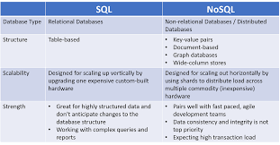
comparison between MongoDB and SQL

